Slide 1
DATAKLIQ EXCEL FINAL PROJECT DOCUMENTATION
BY
ZABIA MARY BALOGUN

Slide 2
Introduction
This is a documentation that shows the steps I took while carrying out my DataKliq Excel Final Project.
In this work, I extracted raw covid19 time series data set from the web
https://github.com/CSSEGISandData/COVID-19/tree/master/csse_covid_19_data/csse_covid_19_time_series
It was cleaned using power query and loaded to Microsoft Excel for further use. The cleaned data was later used to Create a pivot table, pivot charts and also a Covid19 Dashboard, showing the Top 5 Countries with confirmed cases of Covid19, Top 5 countries with highest deaths from Covid19, Number of Confirmed Cases by Year and Number of Deaths by Year.

Slide 3
Process of Extraction and Cleaning of Data
Here we need to extract the global confirmed cases, global recovered cases and global deaths.
To extract the global confirmed cases
Opened the link https://github.com/CSSEGISandData/COVID-19/tree/master/csse_covid_19_data/csse_covid_19_time_series
Then clicked on time series covid19 confirmed global.csv
Click view raw and copy the link.
From there you go to excel, go to data tab, click get data from web. A box pops up where you paste the copied URL and click ok. These opens up a window showing the data set
Click transform data and that takes you to power query.
In the power query, notice that headers are called column1, column2,…
We will need to use the first row as headers.
On the home tab, click on first row as headers. That automatically changes them to headers.

Slide 4
We also noticed that the columns are more than the rows so we unpivot it by highlighting the first four columns, right click and press unpivot other columns. After that, those many columns turned to two columns and we named them date and confirmed, respectively.
To make our data real time, we removed “columns-981” from the formula bar so that anytime we refresh, our data updates. Then we renamed our table confirmed
We repeat the same process to extract the death global data and recovered global data
Next, we merge the 3 tables together
Go to confirmed on the left side of the table
On the home tab, click on the drop down beside merge query, then click on merge as new.
You can only merge two tables at once.

Slide 5
A merge table opens showing the confirmed table and death table.
On the confirmed table, select province/state, country/region and date . On the death table select province/state, country/region and date and press ok.
Now, a merged version of confirmed and death is created.
On the table, click on the right side on the death column, a table pops out, select only death and click ok. Rename the table from death one as Death.
Next, merge with recovered.
Click on merge queries
Merge with province/state, country/region and date and click ok.
This takes you back to the merged table, go the right side of the recovered column, click and select only recovered, then click ok.
Rename recovered 1 to recovered and press ok.
Rename the merged data as ConsolidatedData.
On the home tab Click Close and load. These loads your data into excel.
I checked my data to see if my data types are accurate before proceeding.

Slide 6
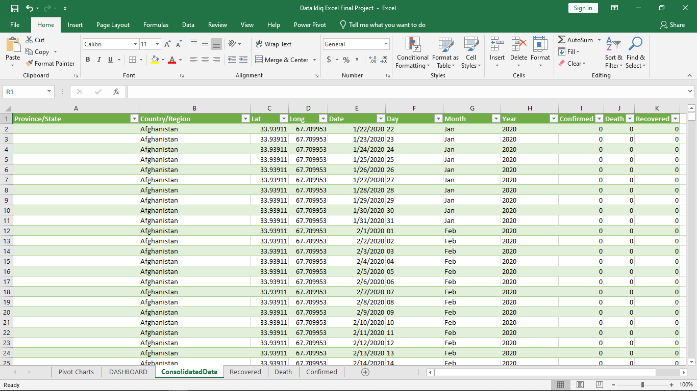
Table 1: A table showing part of the merged data

Slide 7
Next, create a pivot table
Select the whole ConslidatedData table using ctrl+A, on the insert tab click Pivot table.
A table pops out, select new worksheet and click ok. This takes you straight to pivot table.
The first question we will answering is top 5 Countries with highest Confirmed Cases.
So, on the pivot table field select Country/region and Confirmed.
On the pivot field, select value field setting, click on max and press ok.
Filter it to the top 5 countries with confirmed cases. Click on value filters and change it to top 5. click ok
Click on filter option, click on more sort options. Select descending order and click ok.
Create a bar chart and name it top 5 confirmed cases.

Slide 8
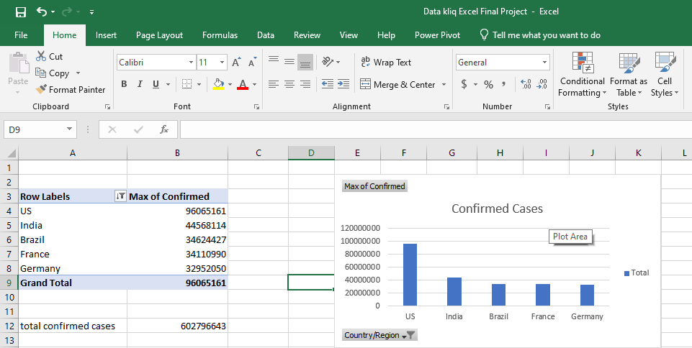
Table2: A table showing a bar chart the contains the top 5 countries with confirmed cases

Slide 9
The second question we will answering is top 5 Countries with highest death.
So, on the pivot table field select Country/region and death.
On the pivot field, select value field setting, click on max and press ok.
Filter it to the top 5 countries with death cases. Click on value filters and change it to top 5. click ok
Click on filter option, click on more sort options. Select descending order and click ok.
Create a bar chart and name it top 5 death cases.

Slide 10
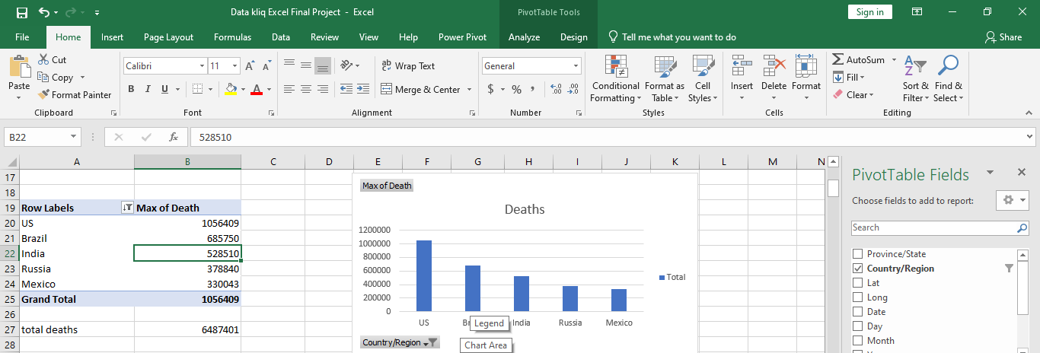
Table3: A table showing the top 5 Countries with highest deaths

Slide 11
The third question we will be answering is number of confirmed cases by year
on the pivot table field select confirmed and year.
On the pivot field, select value field setting, click on max and press ok.
Create a line chart and name it confirmed by year
The final question we will answering is number of death cases by year.
on the pivot table field select death and year.
On the pivot field, select value field setting, click on max and press ok.
Create a line chart and name it death by year

Slide 12
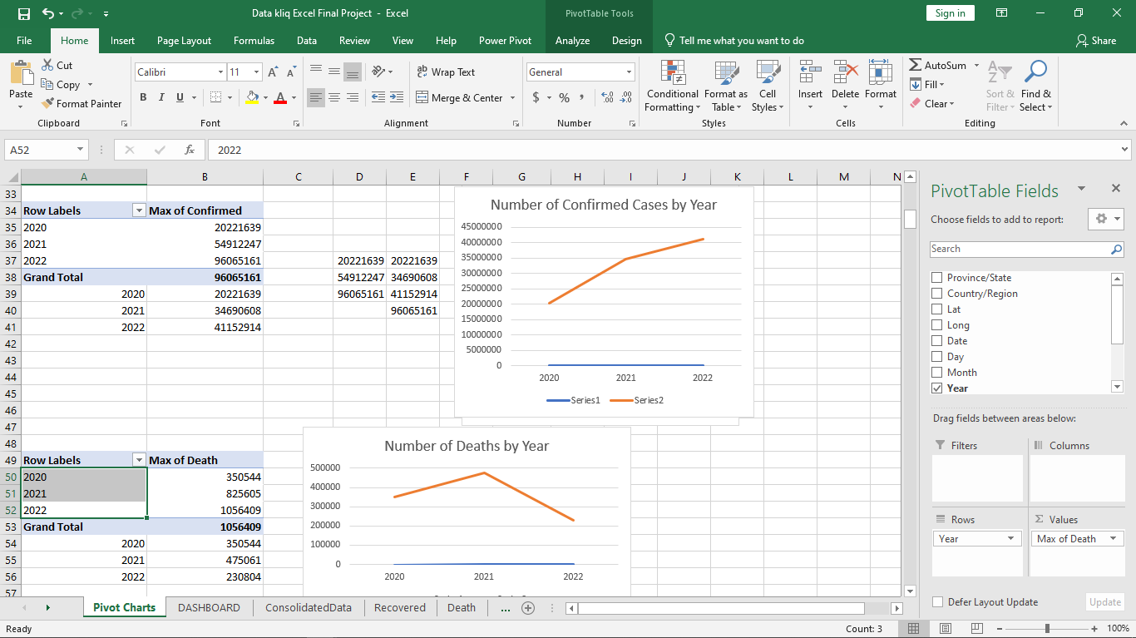
Table4: A table showing number of confirmed cases and number deaths by Year

Slide 13
Next, calculate Total Number of Confirmed Cases, Total number of deaths and death rate
Total Number of Confirmed Cases =602,796,643
Total Number of Deaths =6,487,401
Death Rate = (6,487,401/ 602,796,643)*100
=1.08%
Finally, use all the charts and Calculated information to Create a Covid19 Dashboard.

Slide 14
